Slide 1
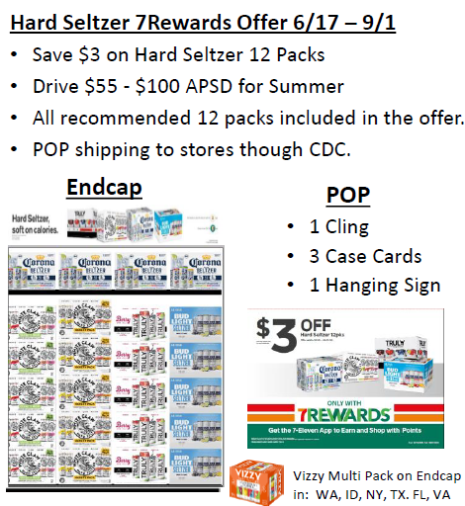
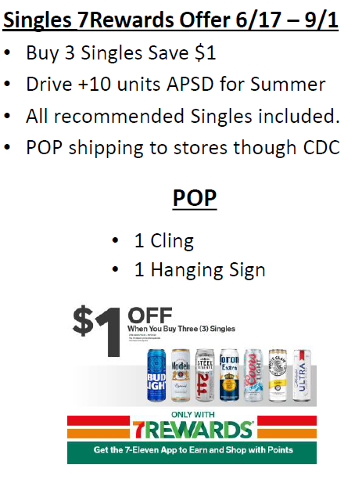
June 17th – Sept 1th – Harder Seltzer & Singles 7Rewards Offer
Harder Seltzer 7Rewards Offer
Singles 7Rewards Offer
Endcap Header Card
Cooler Door Decal
Display Case Card
Cooler Door Decal
*Offer Includes ALL Single Serve
*stores should have received ALL the POS in there Monthly Kit. Please check at store level.

Slide 2
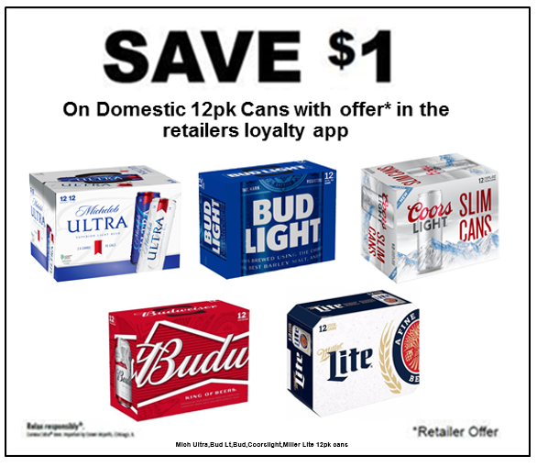
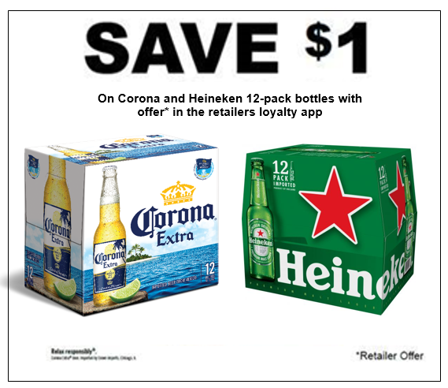
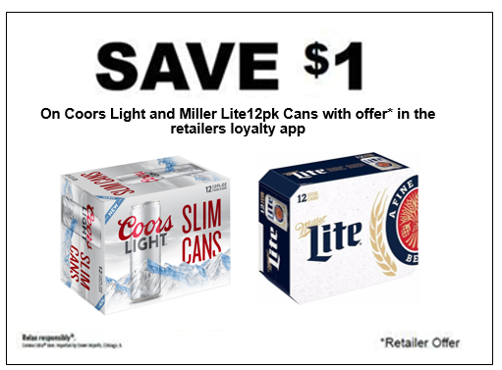
May 29th – Sept 1th – 12pk SUMMER KVI (Know value item)
WYD COOLER DOOR DECAL
ALL BRANCHES POS
ALL OTHER BRANCHES COOLER DOOR DECAL
* Display case cards are being printed for each Brand Corona,Heineken,Coorslight and Miller Lite

