Slide 1
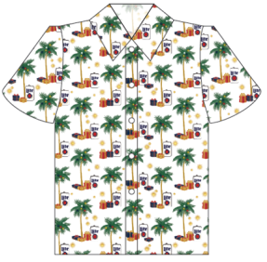
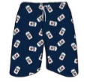
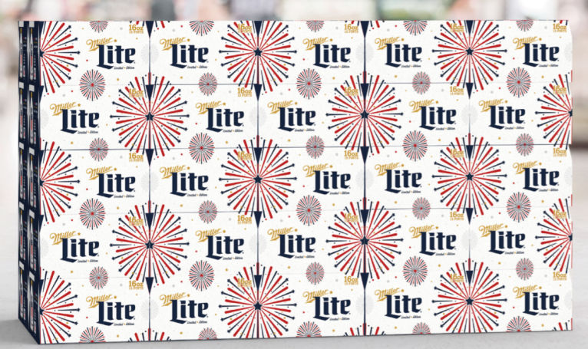
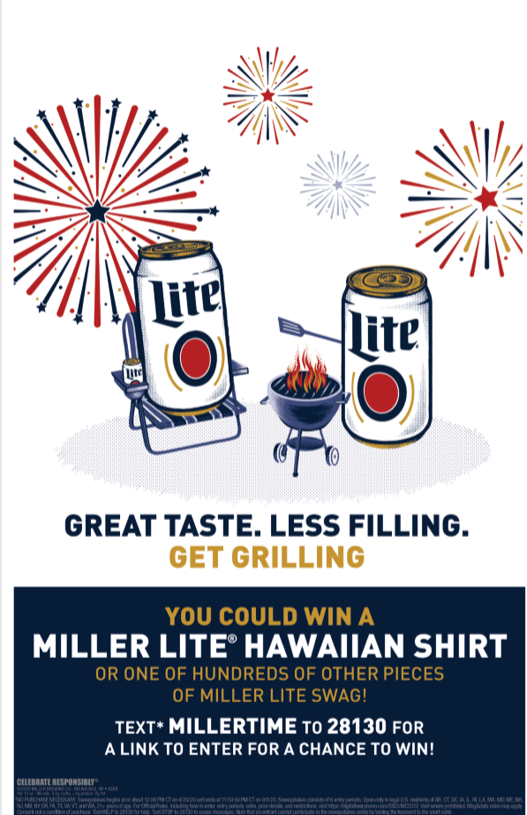
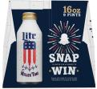
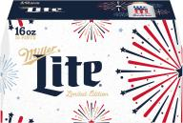
Hawaiian Shirt
Miller Lite Summer Program
WIN
Timing: May – July.
Packages: 9pk pints + large drive pack (18/24/30)
Merchandising: Pole Toppers, Case Cards for Sweeps and Rebates
Sweeps: Custom prize pool to win shirt and other summer swag.
Insights:
Miller Lite is the #1 brand at Acme and #2 for incremental $ growth YTD
9pk pints are the #2 ML pack at Acme, #4 growing Premium Light pack, and growing faster than total Miller Lite, total beer category, total Premium Lights.
Summer packaging on pints. Win more prizes with on-pack snapcode

Slide 2
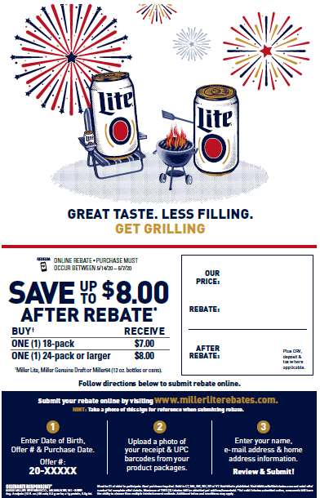
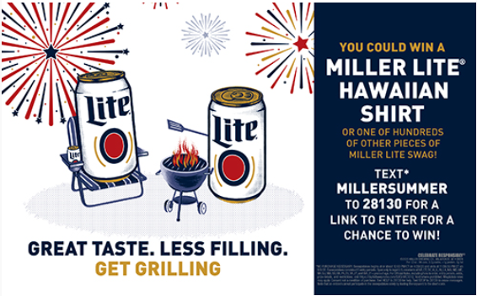
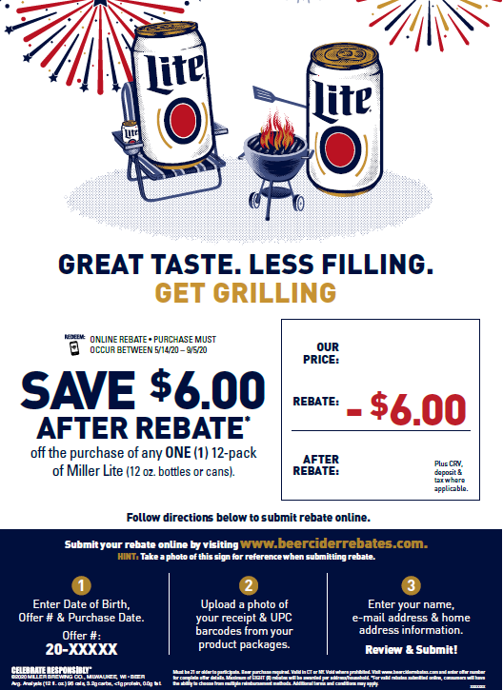
Graphics Library Assets
Summer Sweeps Text to win prizes Live 4/29 – 9/8 11 x 17 Case Card GL Asset #MILL20200498555 Notes Acme ONLY! 1 per store ordered and shipped to distributors Updated template available in June | Digital Text to Rebate (NY + CT) $7 off 18pk / $8 off 30pk 5/14 – 6/7 11 x 17 Case Card GL Asset #MILL202004610386397608
Summer Sweeps Text to win prizes Live 4/29 – 9/8 11.25 x 7 Price Sign (fits into holders, or blow up for banner) GL Asset #MILL2020049912988 | Digital Text to Rebate (NY + CT) $6 off ONE 12pk 5/14 – 6/7 11 x 17 Case Card GL Asset #MILL2020046165752890129

