Slide 1
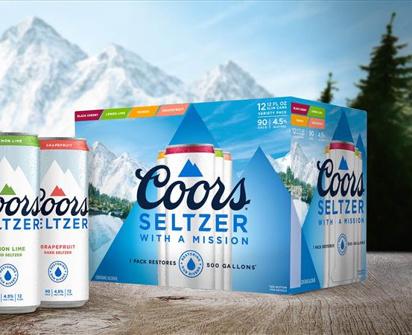
CVS Coors Hard Seltzer Activation
COORS SELTZER VARIETY PACK 12OZ CAN 2/12
MBD Item #6160
CVS Item #543196
UPC 0-71990-00015-8
Everyday Retail: $15.99 @17% Margin
Notes -
Coors Seltzer 12pks will replace Henry’s Hard Seltzer (CVS Item #449707) in all stores.
Select stores will receive a case shipper. CVS DL approved List provided as well.
CVS Corp requested Warm Distribution, or small stacks in ALL stores where case stackers are not in the Sept- Oct Planner.

Slide 2
CVS Coors Hard Seltzer
Case Shipper Authorization
Approved Case Shipper Store List by GSM (92) stores
Cregin (11) Authorized
Hourihan (20) Authorized
Kiely (8) Authorized
Munson (12) Authorized
Quinones (6) Authorized
Romero (2) Authorized
Yonick (33) Authorized
Case STACKS are approved in ALL locations, outside of shipper authorized stores.
List attached.

