Slide 1
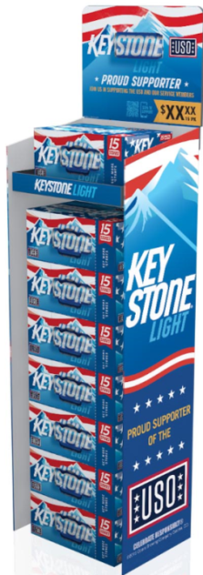
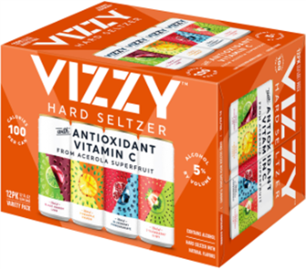
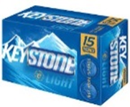
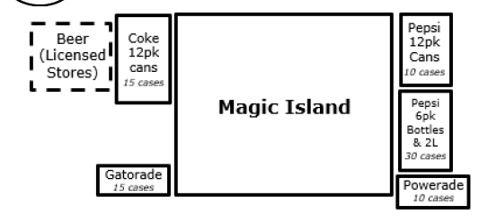
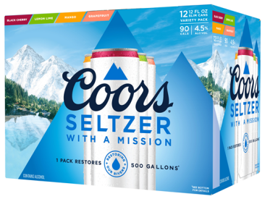
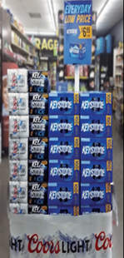
Upcoming Activity – September 2020– New York
In Store Execution
Keystone Light 15pks are in the MAG
MAG (monthly activity guide) is the game plan that is used by store employee’s
Vizzy should be placed in every cooler if inventory is on hand
Utilize a Vizzy static sticker on the cooler door
Coors Seltzer will be mandated in every cooler starting 9-1
Options for Incremental Display activity
There are no rules against us putting beer on the floor
Premium 2-12 and 18-12oz cans are the top selling packages
September (MAG) Monthly Activity Guide
MBD Key Account Executive-Jackie Lettieri

