Slide 1
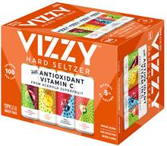
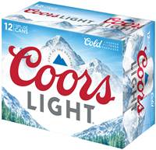
MANDATORY STACK PROGRAM
Who: Price Chopper - all states
What: Vizzy 12-packs & Coors Light 12-packs
When: 8/2/20- 8/29/20
Graphic Library MIR Asset #:
Vizzy - VY20200624106687
CL - CL2020046176807

