Slide 1
SPEEDWAY PLANNER
Nov 1 to Dec 31 2020

Slide 2
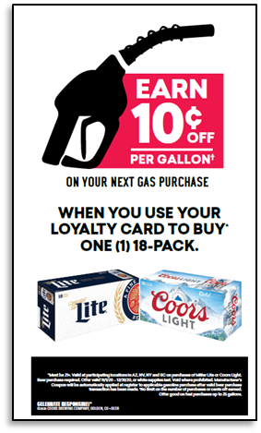
SPEEDWAY PLANNER Nov 1 to Dec 31 2020
UGLY CHRISTMAS SWEATER PROMO-CORONA /MODELO
MOLSON COORS 18pk $.10C OFF GAS PROMO
Corona Extra 18pk "feliz Navidad" Promo
HEINEKEN "GET $5 OFF 12PK"
*Sweaters have yet to arrive. To be used as display enhancer.
Corona & Modelo 12pks
Corona Extra 18pk
$16.49
$25.49

